Slide 1
An Introduction to WEKA and Weka Explorer

Slide 2

What is WEKA?
Waikato Environment for Knowledge Analysis
It’s a data mining/machine learning tool developed by Department of Computer Science, University of Waikato, New Zealand.
Weka is also a bird found only on the islands of New Zealand.

Slide 3
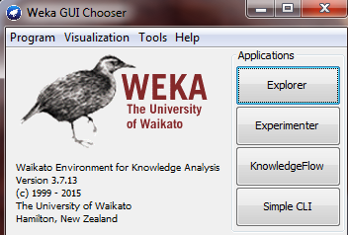
Main GUI
Three graphical user interfaces
“The Explorer” (exploratory data analysis)
“The Experimenter” (experimental environment)
“The KnowledgeFlow” (new process model inspired interface)

Slide 4
Weka has a Package Manager, which can be used to install additional modules very easily

Slide 5
Explorer: pre-processing the data
Data can be imported from a file in various formats: ARFF, CSV, C4.5, binary
Data can also be read from a URL or from an SQL database (using JDBC)
Pre-processing tools in WEKA are called “filters”
WEKA contains filters for:
Discretization, normalization, resampling, attribute selection, transforming and combining attributes, …

Slide 6
WEKA only deals with “flat” files
@relation heart-disease-simplified
@attribute age numeric
@attribute sex { female, male}
@attribute chest_pain_type { typ_angina, asympt, non_anginal, atyp_angina}
@attribute cholesterol numeric
@attribute exercise_induced_angina { no, yes}
@attribute class { present, not_present}
@data
63,male,typ_angina,233,no,not_present
67,male,asympt,286,yes,present
67,male,asympt,229,yes,present
38,female,non_anginal,?,no,not_present
...
Flat file in ARFF
(Attribute-Relation
File Format) format
6

Slide 7
WEKA only deals with “flat” files
@relation heart-disease-simplified
@attribute age numeric
@attribute sex { female, male}
@attribute chest_pain_type { typ_angina, asympt, non_anginal, atyp_angina}
@attribute cholesterol numeric
@attribute exercise_induced_angina { no, yes}
@attribute class { present, not_present}
@data
63,male,typ_angina,233,no,not_present
67,male,asympt,286,yes,present
67,male,asympt,229,yes,present
38,female,non_anginal,?,no,not_present
...
numeric attribute
nominal attribute

Slide 8
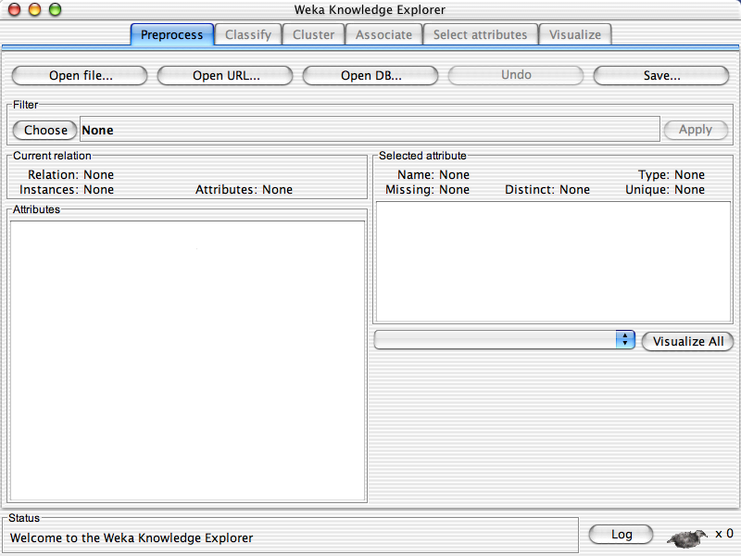

Slide 10
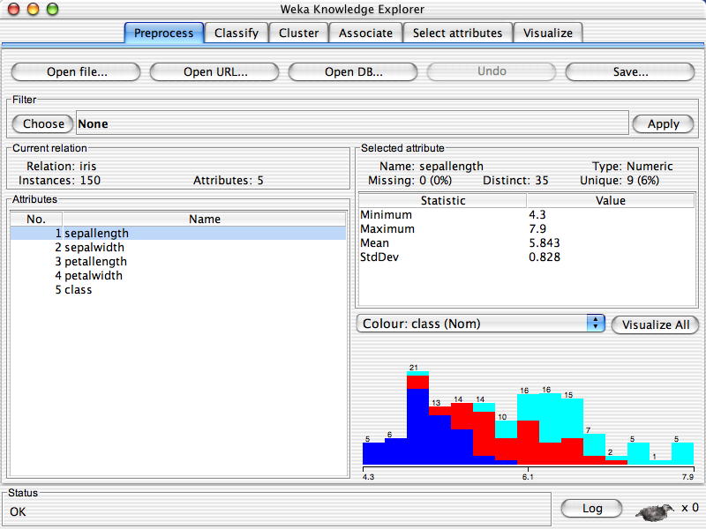

Slide 12
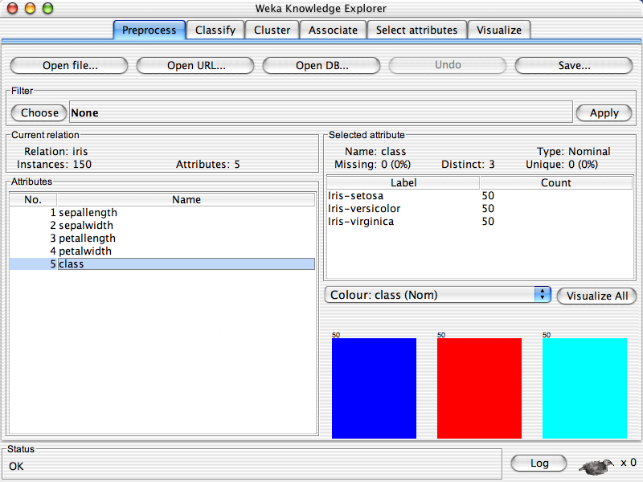

Slide 14
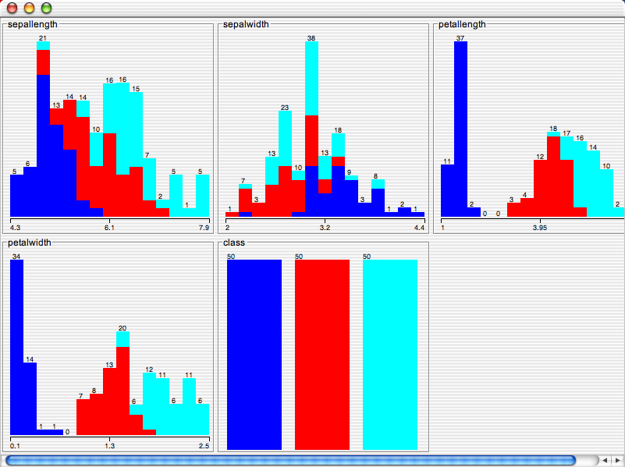

Slide 15
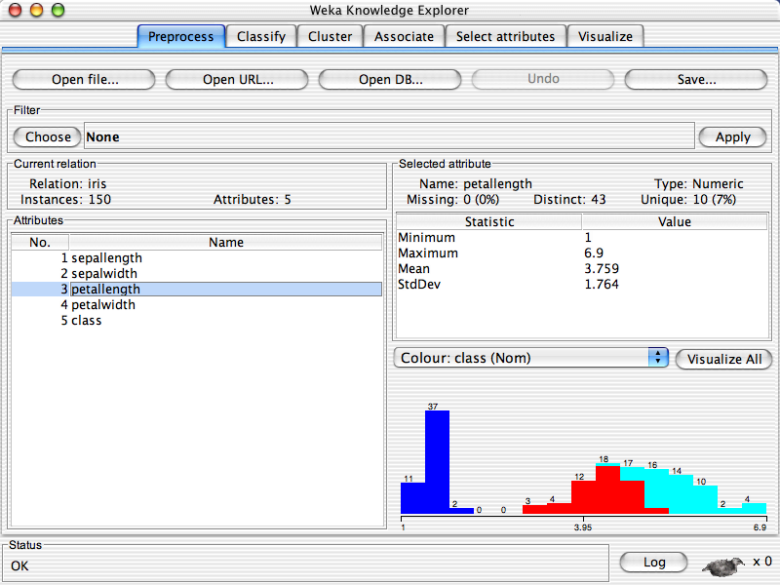

Slide 17
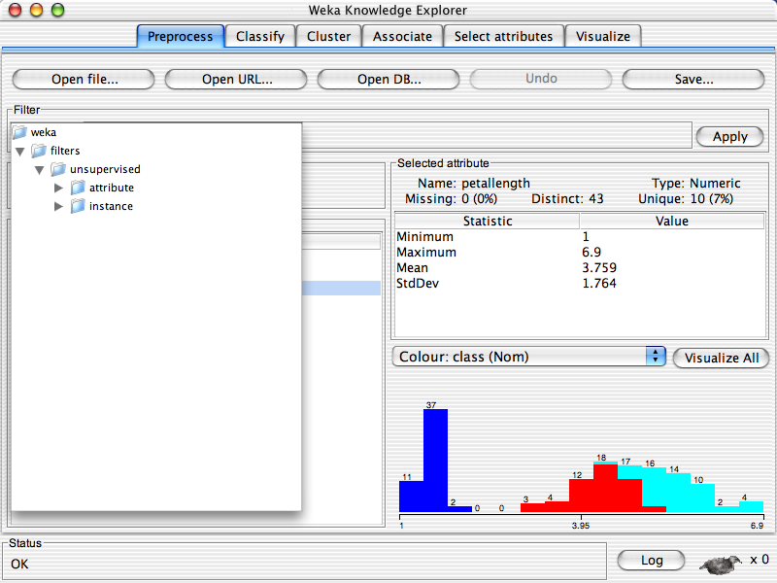

Slide 19
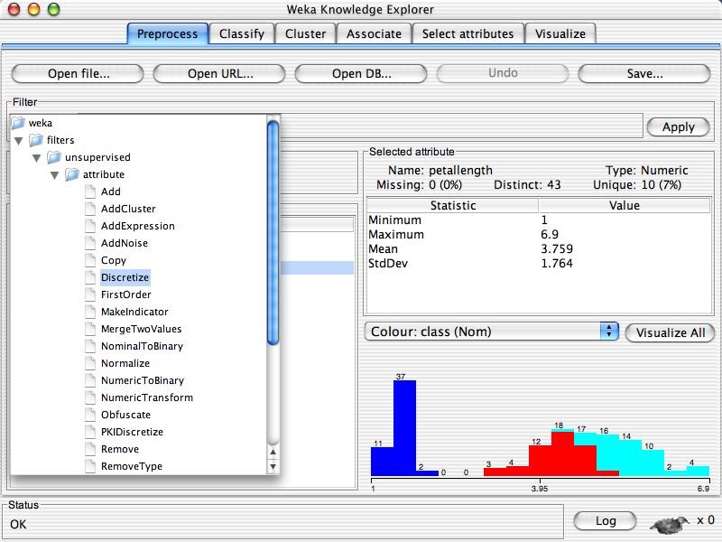

Slide 20
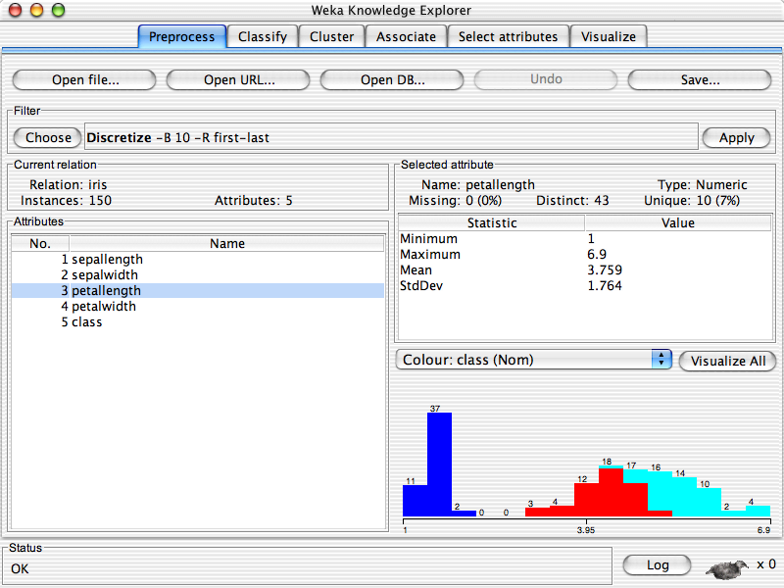

Slide 22
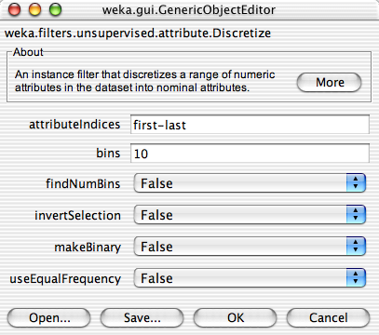

Slide 24
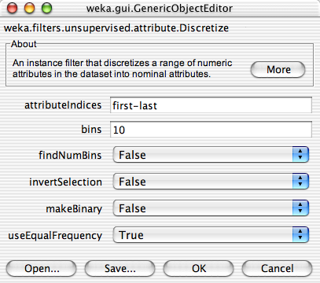

Slide 26


Slide 28
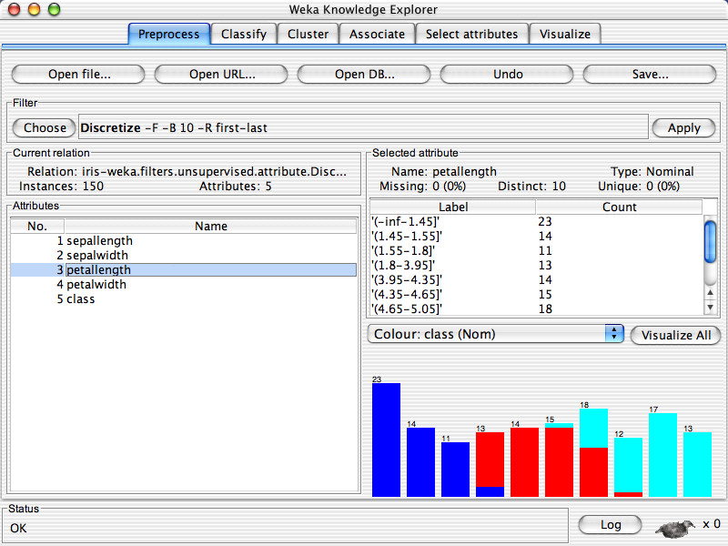

Slide 29
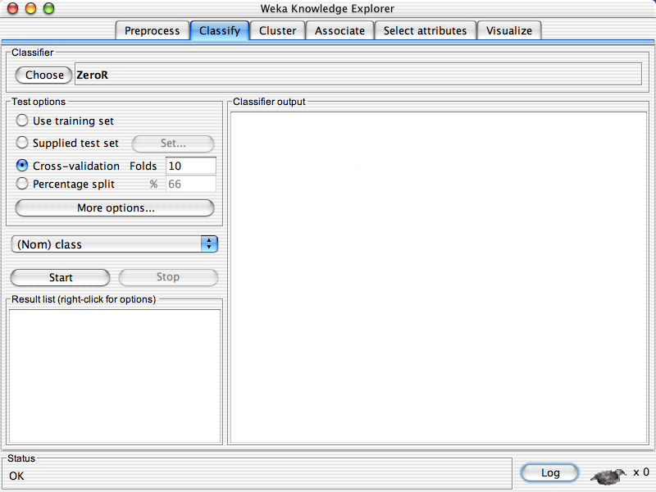

Slide 31
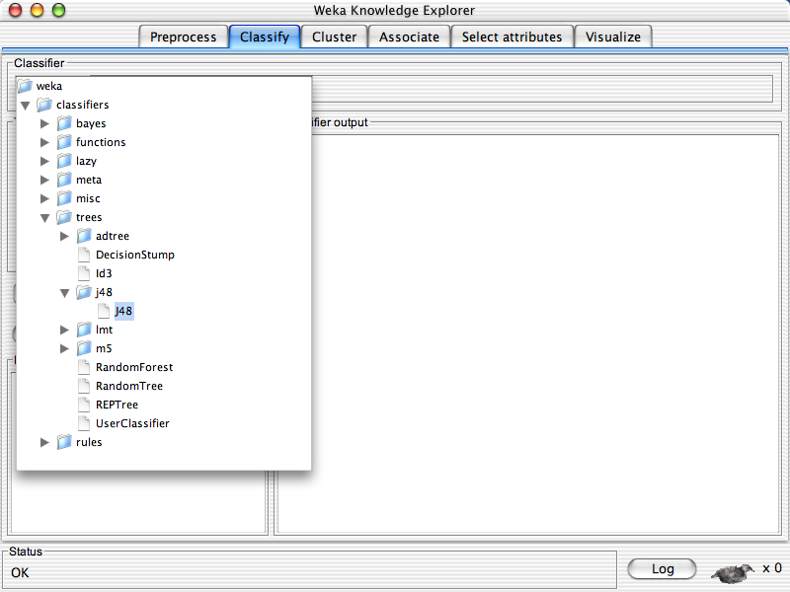

Slide 32
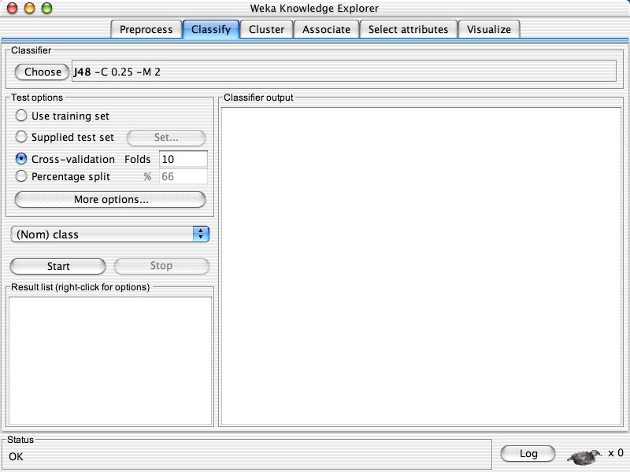

Slide 34
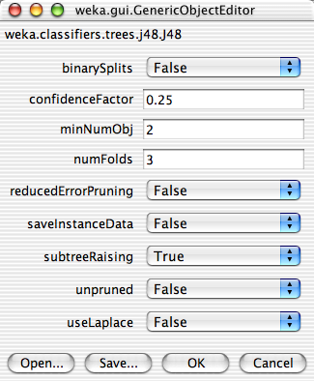

Slide 38
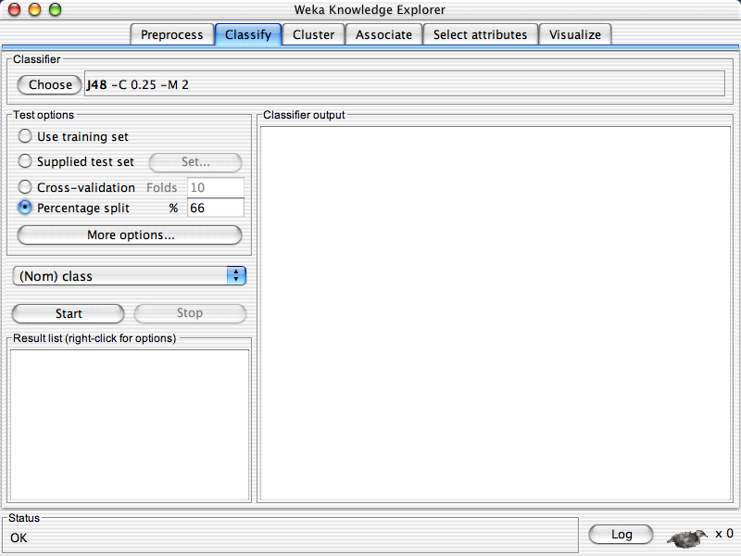

Slide 40
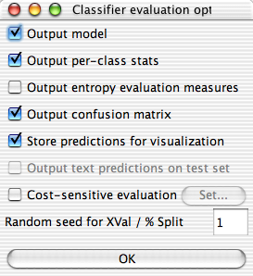

Slide 44
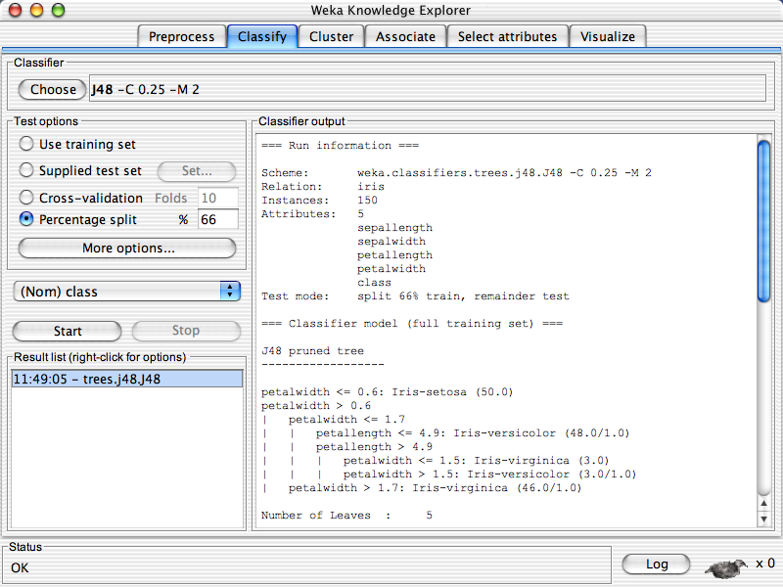

Slide 46
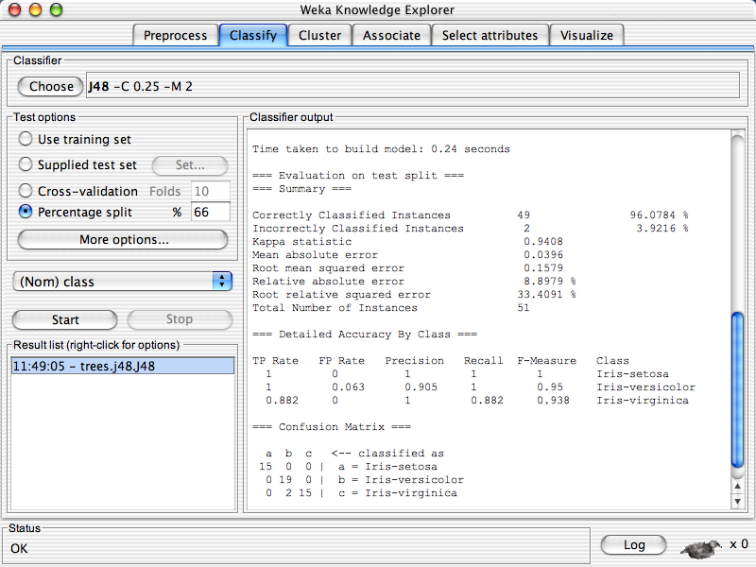

Slide 48
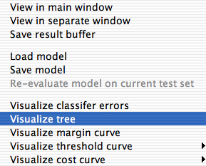

Slide 49
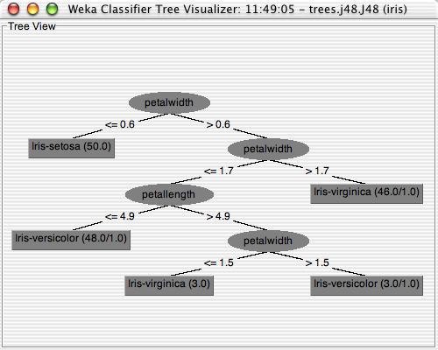

Slide 51
Weka and Deep Learning
First, you will have to install the package "wekaDeeplearning4j" before running any of the available WEKA Application.
The following neural network layers are available to build sophisticated architectures:
ConvolutionLayer: applying convolution, useful for images and text embeddings
DenseLayer: all units are connected to all units of its parent layer
SubsamplingLayer: subsample from groups of units of the parent layer by different strategies (average, maximum, etc.)
BatchNormalization: applies the common batch normalization strategy on the activations of the parent layer
LSTM: uses long short term memory approach
GlobalPoolingLayer: apply pooling over time for RNNs and pooling for CNNs applied on sequences
OutputLayer: generates classification / regression outputs

Slide 52
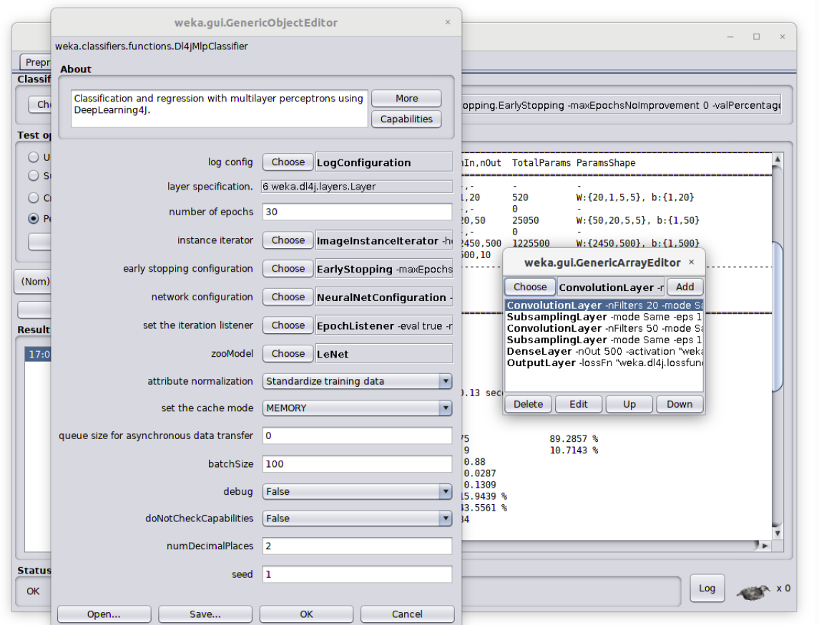

Slide 53
Explorer: clustering data
WEKA contains “clusterers” for finding groups of similar instances in a dataset
Implemented schemes are:
k-Means, EM, Cobweb, X-means, FarthestFirst
Clusters can be visualized and compared to “true” clusters (if given)
Evaluation based on loglikelihood if clustering scheme produces a probability distribution

Slide 54
The K-Means Clustering Method
Given k, the k-means algorithm is implemented in four steps:
Partition objects into k nonempty subsets
Compute seed points as the centroids of the clusters of the current partition (the centroid is the center, i.e., mean point, of the cluster)
Assign each object to the cluster with the nearest seed point
Go back to Step 2, stop when no more new assignment

Slide 55
Explorer: finding associations
WEKA contains an implementation of the Apriori algorithm for learning association rules
Works only with discrete data
Can identify statistical dependencies between groups of attributes:
milk, butter ⇒ bread, eggs (with confidence 0.9 and support 2000)
Apriori can compute all rules that have a given minimum support and exceed a given confidence

Slide 56
Basic Concepts: Frequent Patterns
Tid | Items bought
10 | Beer, Nuts, Diaper
20 | Beer, Coffee, Diaper
30 | Beer, Diaper, Eggs
40 | Nuts, Eggs, Milk
50 | Nuts, Coffee, Diaper, Eggs, Milk
itemset: A set of one or more items
k-itemset X = {x₁, …, x_{k}}
(absolute) support, or, support count of X: Frequency or occurrence of an itemset X
(relative) support, s, is the fraction of transactions that contains X (i.e., the probability that a transaction contains X)
An itemset X is frequent if X’s support is no less than a minsup threshold
Customer
buys both
Customer
buys diaper
Customer
buys beer

Slide 57
Basic Concepts: Association Rules
Tid
Items bought
Find all the rules X → Y with minimum support and confidence
support, s, probability that a transaction contains X ∪ Y
confidence, c, conditional probability that a transaction having X also contains Y
Let minsup = 50%, minconf = 50%
Freq. Pat.: Beer:3, Nuts:3, Diaper:4, Eggs:3, {Beer, Diaper}:3
10
Beer, Nuts, Diaper
20
Beer, Coffee, Diaper
30
Beer, Diaper, Eggs
40
Nuts, Eggs, Milk
50
Nuts, Coffee, Diaper, Eggs, Milk
Customer
buys both
Customer
buys diaper
Customer
buys beer
Association rules: (many more!)
Beer → Diaper (60%, 100%)
Diaper → Beer (60%, 75%)

Slide 58
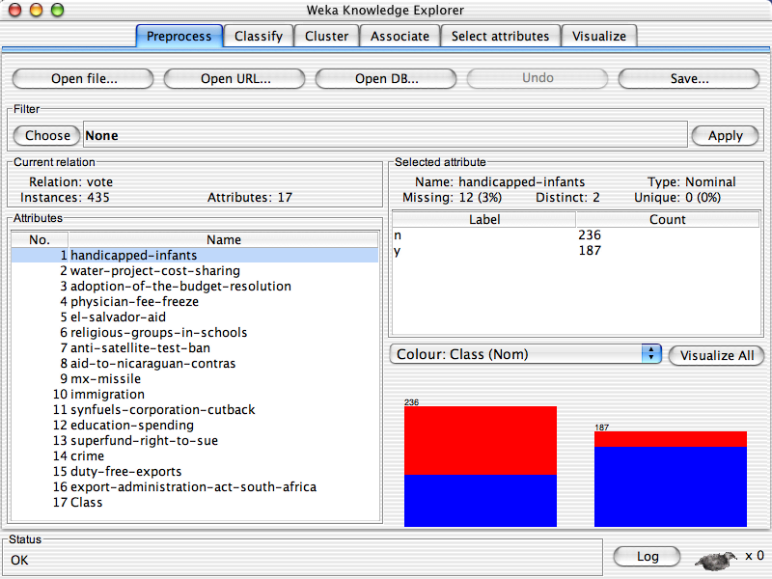

Slide 60
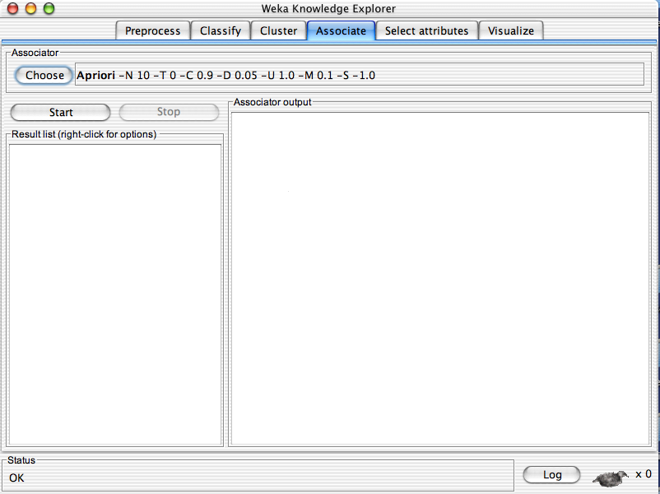

Slide 61
61
University of Waikato
4/14/2022

Slide 63
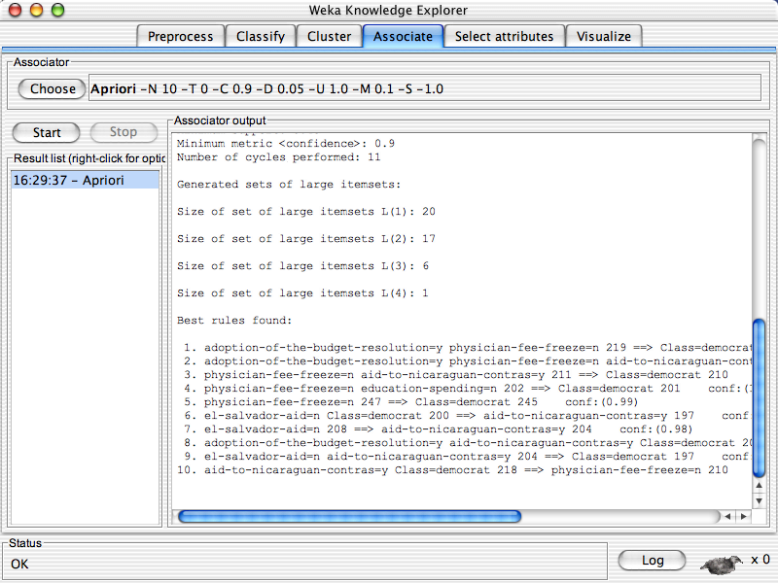

Slide 64
Explorer: attribute selection
Panel that can be used to investigate which (subsets of) attributes are the most predictive ones
Attribute selection methods contain two parts:
A search method: best-first, forward selection, random, exhaustive, genetic algorithm, ranking
An evaluation method: correlation-based, wrapper, information gain, chi-squared, …
Very flexible: WEKA allows (almost) arbitrary combinations of these two

Slide 65
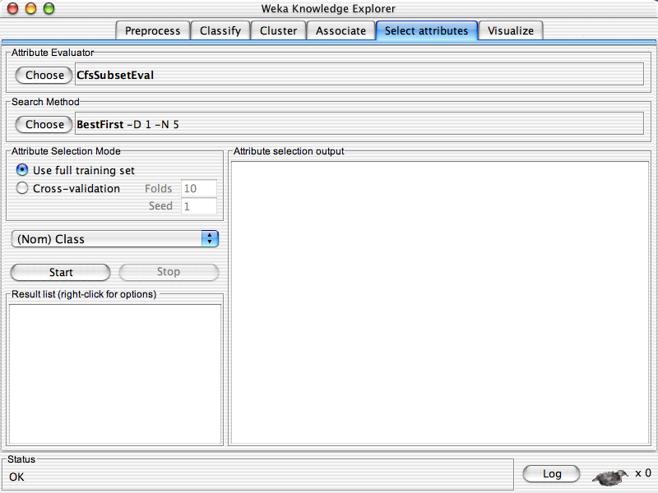

Slide 67
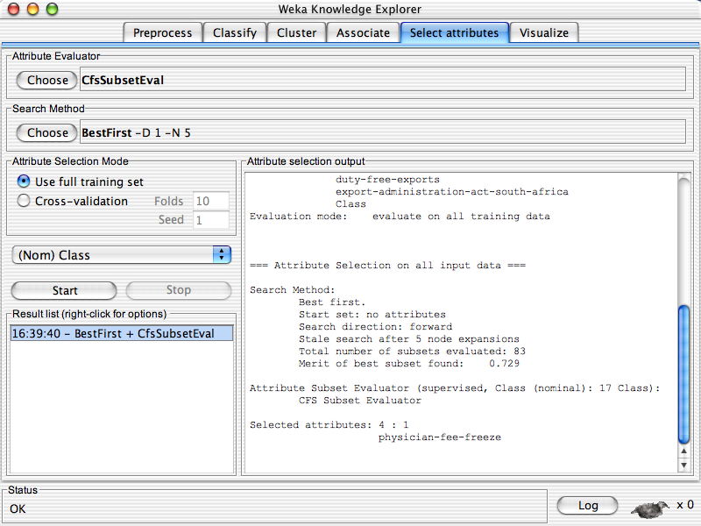

Slide 69
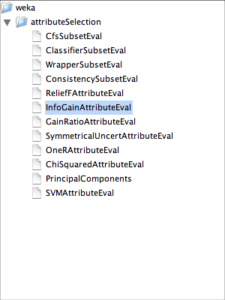

Slide 70
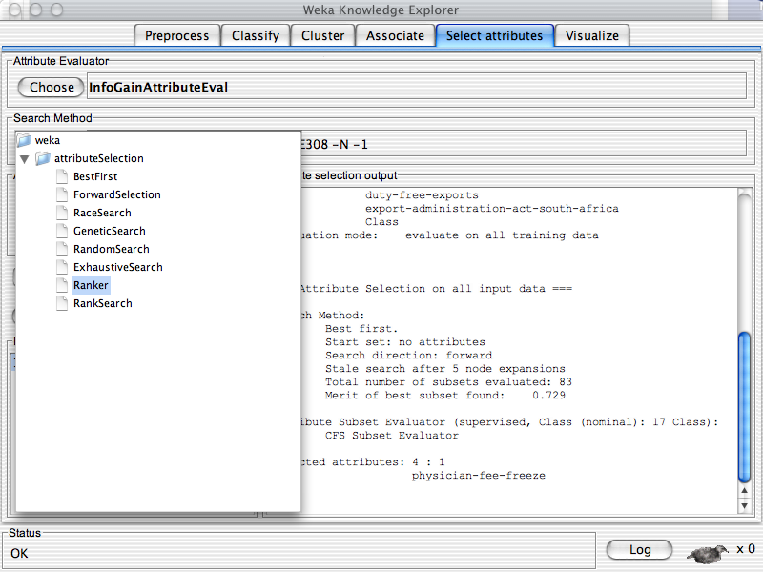

Slide 71
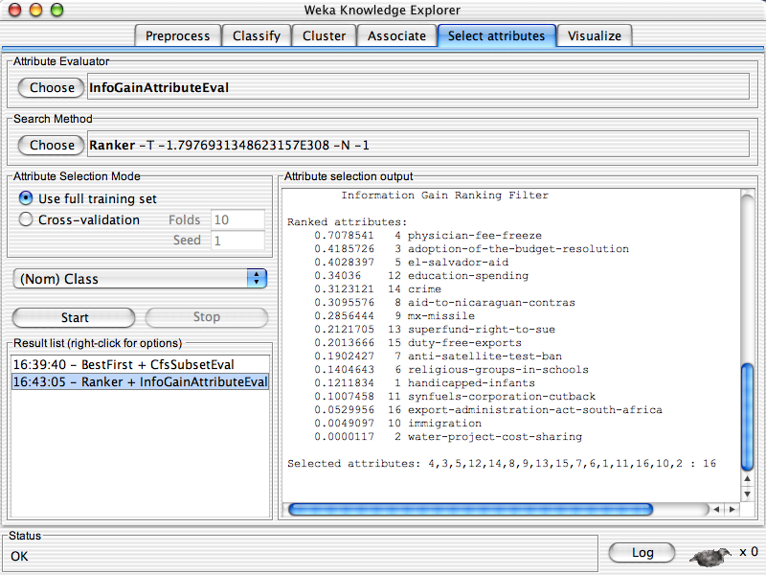

Slide 73
Explorer: data visualization
Visualization very useful in practice: e.g. helps to determine difficulty of the learning problem
WEKA can visualize single attributes (1-d) and pairs of attributes (2-d)
To do: rotating 3-d visualizations (Xgobi-style)
Color-coded class values
“Jitter” option to deal with nominal attributes (and to detect “hidden” data points)
“Zoom-in” function

Slide 74
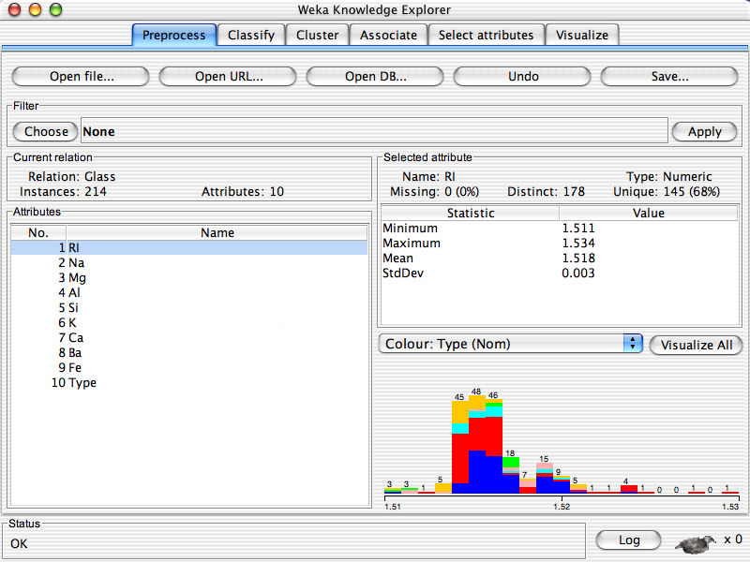

Slide 75
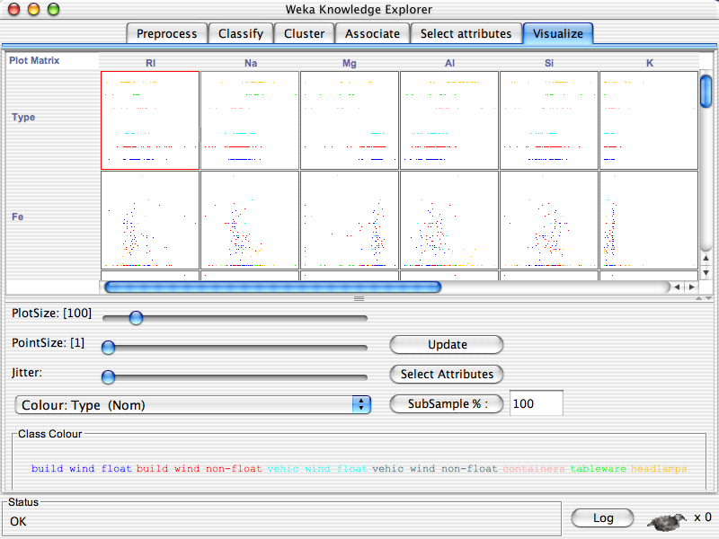

Slide 77
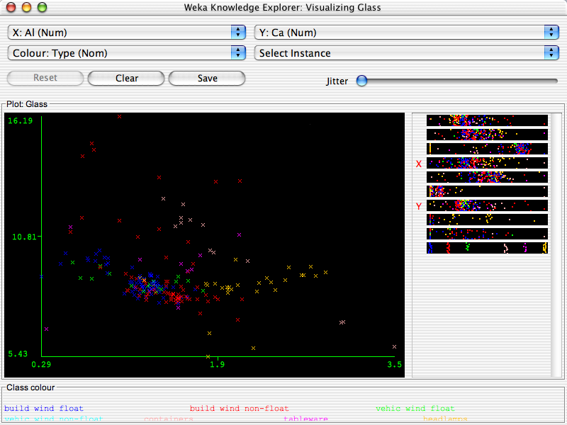

Slide 78
WEKA Tutorial
https://www.youtube.com/watch?v=nHm8otvMVTs

